Slide 1
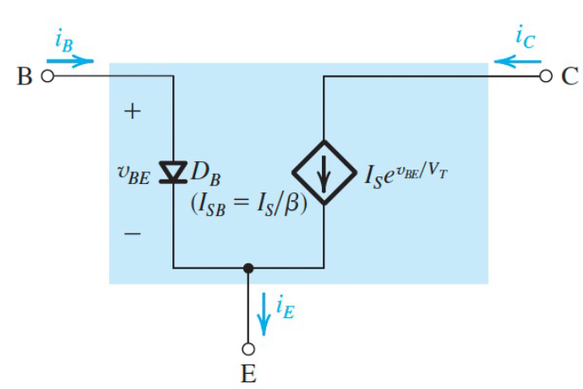
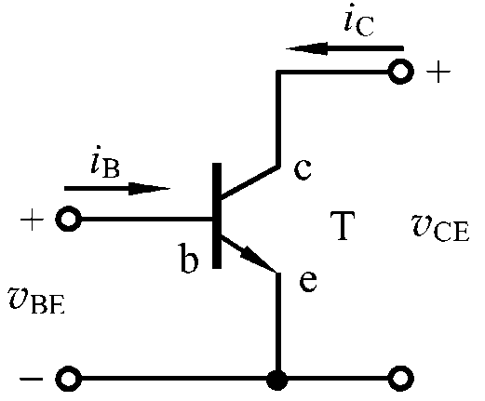
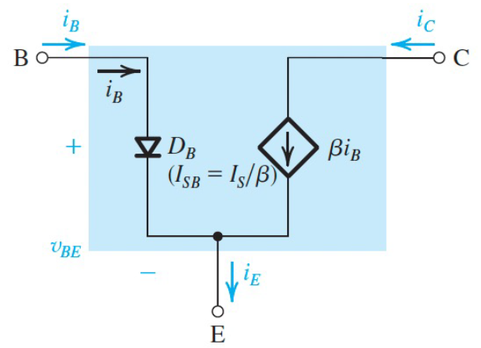
Simple bipolar transistor model

Slide 2
i_{C}
i_{B}
V_{in}

Slide 3
V_{in}
V_{in}
V_{in}

Slide 4
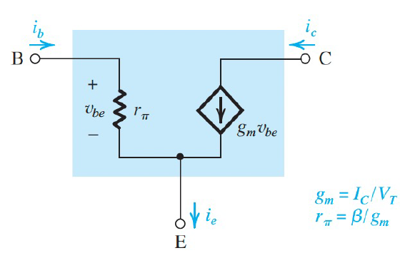
Large-signal model
Small-signal model

Slide 5
Bipolar Junction Transistors
Peng Mei
Department of Electronic Systems
Email: mei@es.aau.dk

Slide 6
Learning objectives:
Early effect
Static operating point in power amplifier design

Slide 7
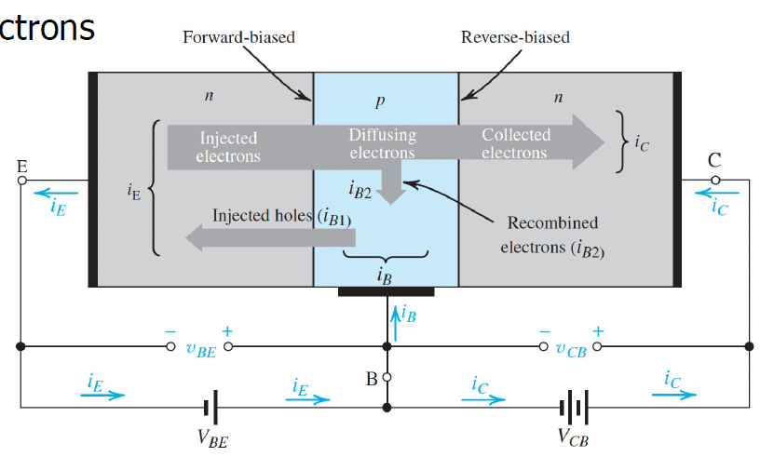
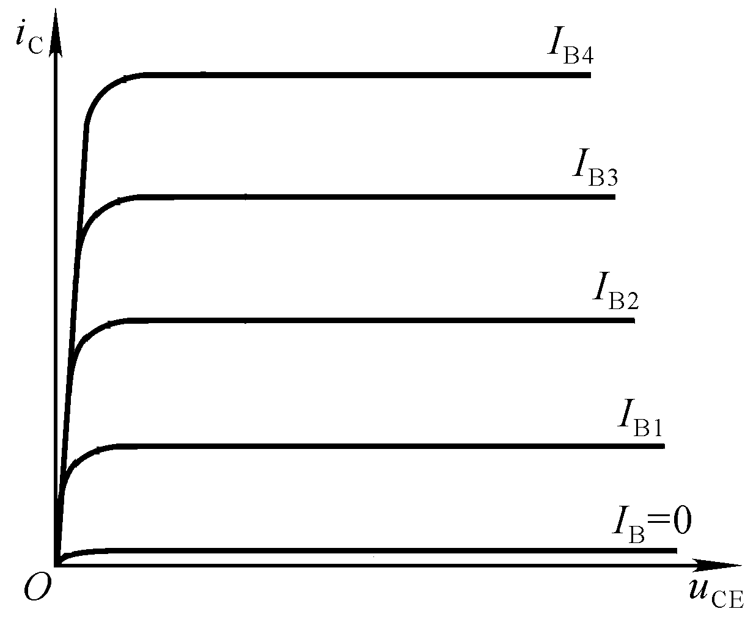
i_{C} ~ υ_{CE} curve:
Saturation
Active
i_{C}:
Cutoff
A big i_{B} results in a big i_{C}.
Electrons E B C
Notes:
Most of electrons will go from E to B, just a miniority of electrons will go through B to arrive C.

Slide 8
Mode | EBJ | CBJ
Cutoff | Reverse | Reverse
Active | Forward | Reverse
Saturation | Forward | Forward
Saturation region: i_{c} is mainly controlled by v_{ce}, βi_{b} > i_{c}
Active region: i_{c} is basically parallel with v_{ce}, βi_{b} = i_{c}
Cutoff region: i_{c} is approaching to 0, i_{b} i_{c} 0

Slide 9
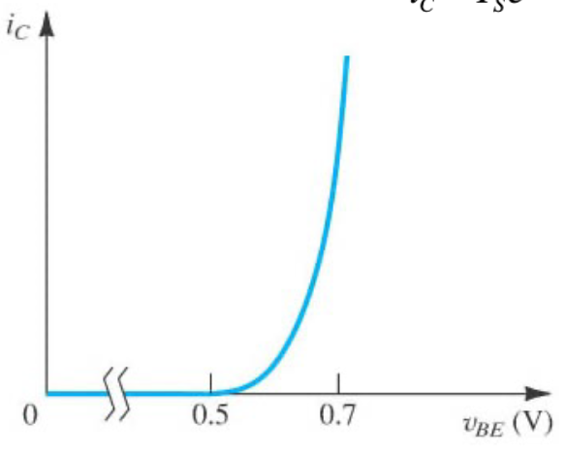
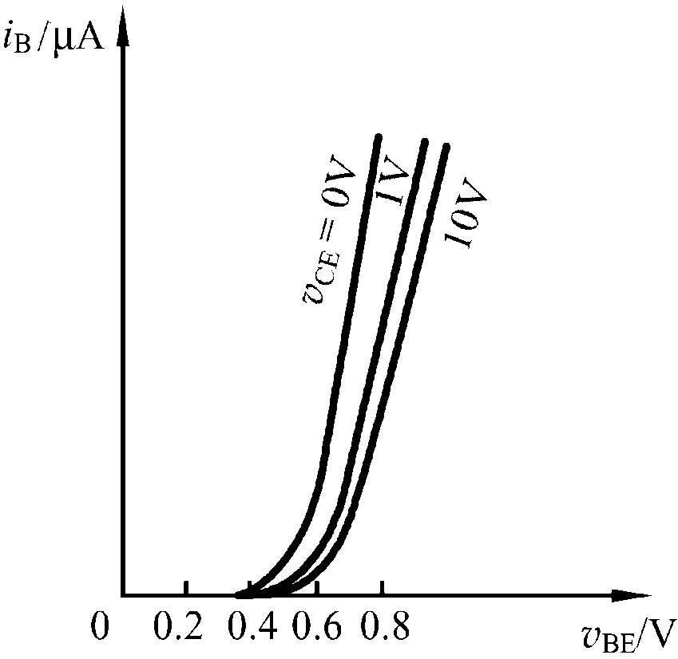
u_{BE} - i_{C}
u_{BE} - i_{B}
u_{CE} - i_{C}

Slide 10
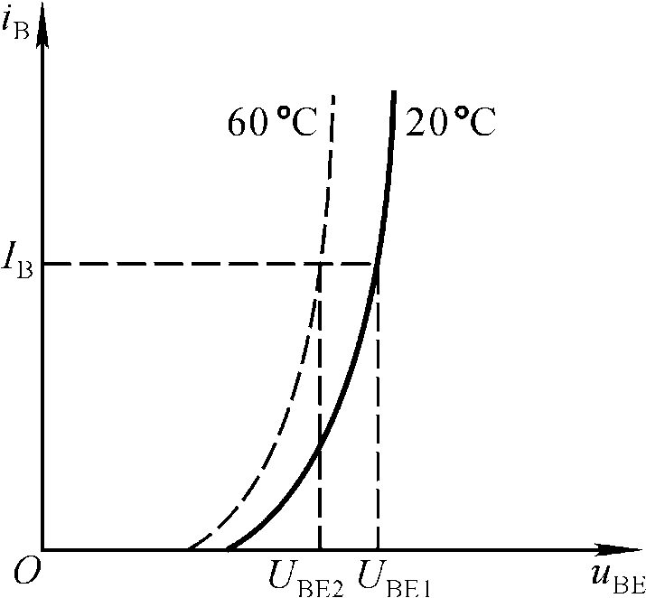
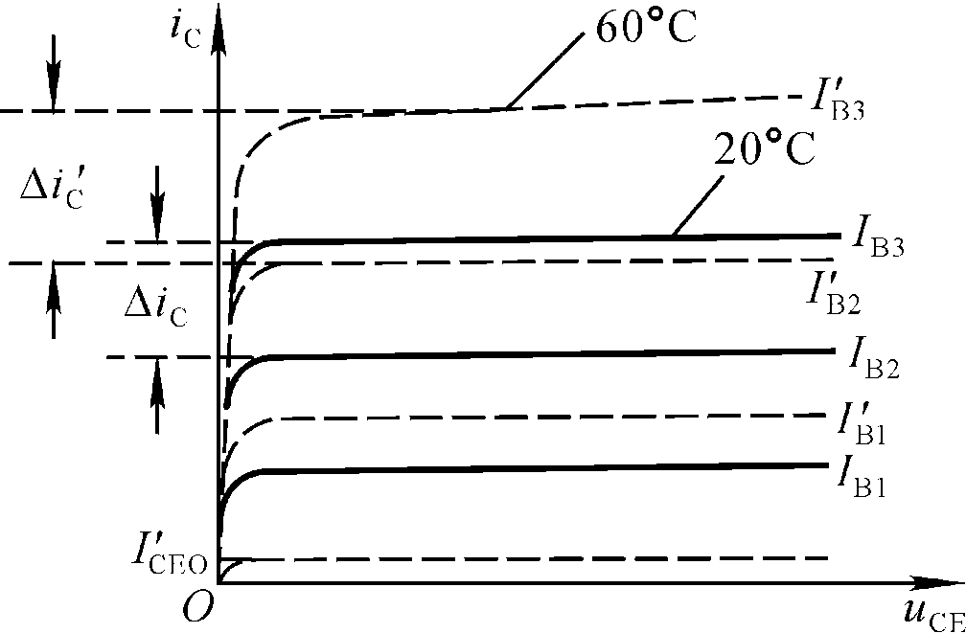
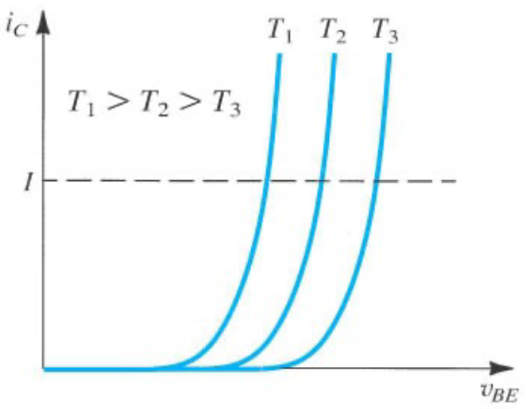
Effects of temperature:

Slide 11
Early effects:
The effects of early voltage on transconductance:
Not change
V_{A} is early voltage

Slide 12
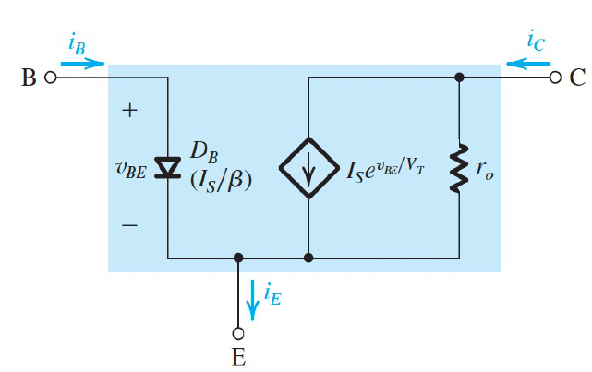
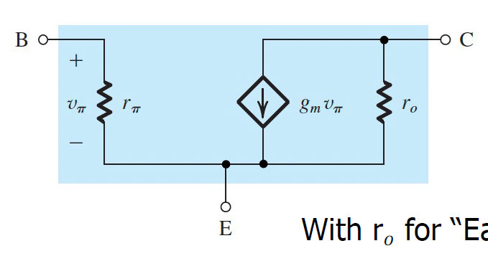
Inclusion of early effect in large-signal and small-signal models:
Notes:
A example should be given here.

Slide 13
Power amplifier:
Saturation
Active
Cutoff
Notes:
VBEQ is the turn-on voltage

Slide 14
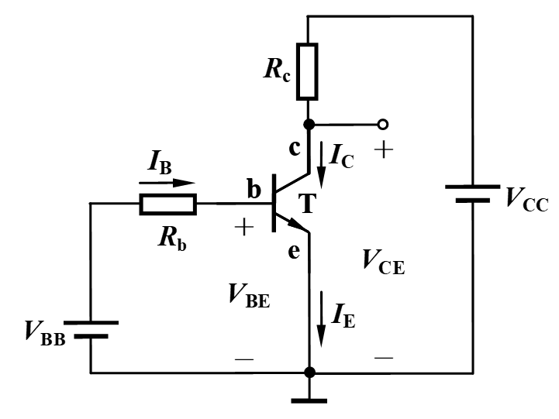
DC biasing (Static operating point (Q point)):
Si: 0.5 – 0.7 V
Ge: 0.1 – 0.3 V
Uon
Q (I_{BQ}, I_{CQ}, V_{CEQ})
Notes:
VBEQ is the turn-on voltage

Slide 15
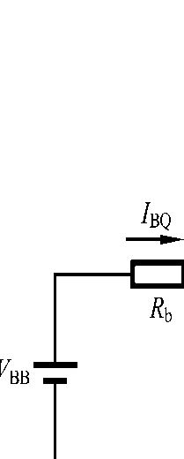
Calculate Q point:
V_{CC}=15V, R_{C}=1.5kΩ, i_{B}=20µA
Q(20µA, 4ｍＡ, 9Ｖ)
V_{CC}=12V, R_{C}=1kΩ, V_{BB}=2.2V, R_{b}=50kΩ, V_{BEQ}=0.7V
Q(30µA, 6ｍＡ, 6Ｖ)
β =200
V_{CC}=6V, R_{C}=200Ω, V_{BB}=3.2V, R_{b}=20kΩ, V_{BEQ}=0.7V
Q(125µA, 25ｍＡ, 1Ｖ)
Notes:
Q(IBQ, ICQ, VCEQ)

Slide 16
Q₃
β =200
step
Q₂
Q₁
Q₁(20µA,4ｍＡ,9Ｖ)
Q₂(30µA,6ｍＡ,6Ｖ)
Q₃(125µA,25ｍＡ,1Ｖ)
Notes:
Q(IBQ, ICQ, VCEQ)

Slide 17
With a perturbation (a sinusoidal signal (alternating signal)):

Slide 18
The effects of static operating point on output voltage
I_{BQ}
I_{CQ}
the voltage on R_{c}
V_{CEQ}
R_{c}
the voltage on R_{c}
V_{CEQ}

Slide 19
The effects of static operating point on amplification
I_{BQ}
I_{CQ}
the voltage on R_{c}
V_{CEQ}
A proper static operating point should be provided to make the transistor operate at the active mode (amplification region).
The amplitude of output signal is limited by V_{CC.}

Slide 20
For DC signal:
Simplified
Alternatives
Q point:
Only one DC power is involved

Slide 21

When AC signal is added directly:
What will happen when v_{s} = 0?
Notes:
Z = 1/j2pifC

Slide 22
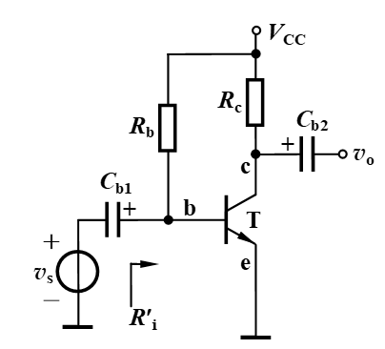
When AC signal is added with capacitors:
Two capacitors are added at input and output ends
to isolate DC and AC signals.
The involvements of v_{s} and v_{o} do not affect the Q
point of the circuit.
The frequency of v_{s} can not be too small.
Notes:
Z = 1/j2pifC

Slide 23
DC circuit and AC circuit:
DC circuit
AC circuit
DC circuit: capacitor is open, AC source is open;
AC circuit: capacitor is short, DC source is short;

Slide 24
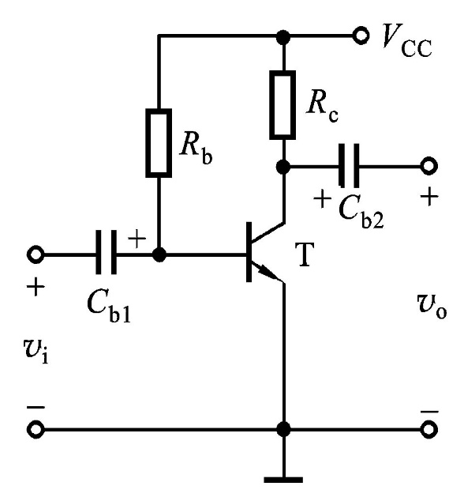
β = 80, R_{b} = 300kΩ , R_{c} = 2kΩ，V_{CC} = +12V
V_{BEQ} is assumed to be 0
Calculate Q point, which region does the BJT operate?
Q (40μA，3.2mA，5.6V)
Active region
If R_{b}=100kΩ,
Q (120μA，6.0mA，0V)
Saturation region
If R_{b} = 300kΩ, R_{c} = 5kΩ
Q (40μA，2.4mA，0V)
Saturation region
Notes:
For subquestion 3, Ic = (VCC – VCES)/Rc, VCES is the voltage between collector and emitter, due to the BJT is operating at saturation región, VCES is quite small which can be ignored when calculate Ic.

Slide 25

Common emitter
Common collector
Common base
Common emitter: signal is input from the base, and output from the collector;
Common collector: signal is input from the base, and output from the emitter;
Common base: signal is input from the emitter, and output from the collector;

Slide 26
Thanks

